Slide 1

ESP-NOW Overview and Implementation

Slide 2
What is ESP-NOW
Two ESP8266 ESP-NOW Implementation
Three ESP8266 ESP-NOW Implementation
Battery Powered Considerations
Summary

Slide 3
What is ESP-NOW ?
ESP-NOW is a kind of connectionless WiFi communication protocol which is defined as Espressif.

Slide 4
Two ESP8266 ESP-NOW Implementation
{"mailbox":{"description": "mailbox opened","supply":3032,"deviceid":18040501}}

Slide 6
Three ESP8266 ESP-NOW Implementation
{“Enviro":{"temp":78.6,"humidity":29,"supply":3041,"deviceid":18040501}}

Slide 8
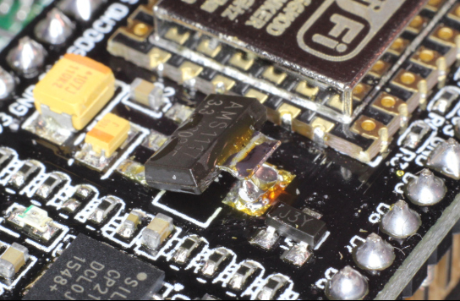
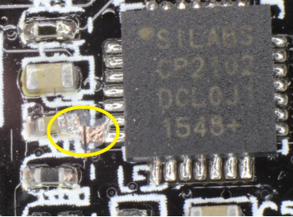
Power Drain Considerations
 | Deep Sleep | Sending Data
All Components | 19.8 mA | 134 mA
Remove Regulator | 16.3 mA | 116 mA
Disconnected UART | 21 uA | 86 mA
Calculations:
Battery: 1000mAh
Deep Sleep
1000mAh/.021mA ~ 2k days (~ 5 years)
Sending Data
Tx(s) < 1sec
[1000mAh/(86mA)] * (3600s/1h) = 42k-sec
Assume 4 cycles/day (~ 28 years)

Slide 9
Summary/Discussion

